Slide 1

Welcome to the SLG Sessions for ULI101

Slide 2
Session’s AGENDA
OPENING ACTIVITY – Ice Breaker type
TWO MAIN ACTIVITIES – provides hands-on practices for major concepts.
CLOSING ACTIVITY – checking our understanding
PRACTICE HANDOUT FOR MID-TERM
Q/As
Notes:
Or a similar course

Slide 3
ICE BREAKER!!!
Welcome to the first activity of SLG sessions.
Thoughts on your PREVIOUS lecture.
Brain Dump on Topics –
1. Difference between
- stdin - stdout- stderr-
2. WHAT IS /dev/null file ->
3. what is Here Document ...?
4. PIPELINE COMMANDS -
5. What are FILTERS..? -->
Notes:
Or a similar course

Slide 4
REQUIREMENT:
BEFORE starting the QUESTIONS:
ACTIVITIES will be a GROUP WORK
Anyone can volunteer to be the group representative
After 20 minutes, we will be discussing and then group representatives will be the ones answering questions on behalf of their group
You can share screens as well as use your microphone in breakout rooms to communicate with your groupmates
This is an open book so feel free to use external resources – notes, websites, etc.
Good luck and please keep in mind – THIS IS A GROUP ACTIVITY AND NOT AND INDIVIDUAL PRACTICE
Notes:
Or a similar course

Slide 5
REQUIREMENT:
BEFORE starting the QUESTIONS:
If you have directory named “slg_for_uli” in your home directory, then issue command “rm –r slg_for_uli” to delete this directory.
Go to your home directory(/home/username) and Issue the following commands
1. mkdir -p slg_for_uli/{shirts/casuals,shirts/formal,Jackets,Denims,Tuxedoes}
2. touch slg_for_uli/Denims/pants.txt slg_for_uli/Denims/chinos.txt
3. touch slg_for_uli/shirts/casuals/polo.txt
Notes:
Or a similar course

Slide 6
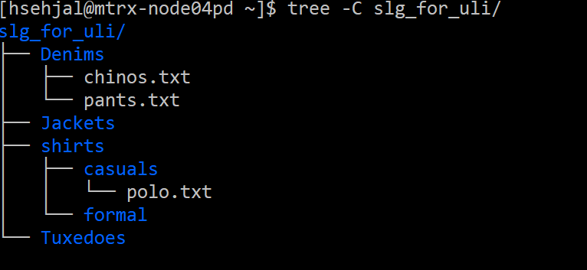
REQUIREMENT:
IMP: confirm your directory structure using the command "tree –C slg_for_uli "
You should get this OUTPUT:
Notes:
Or a similar course

Slide 7
Activity – 1(BREAKOUT ROOM ACTIVITY)
ACTIVITY #1 QUESTIONS:
1. Write a single Linux command to provide a detailed listing of all files in the /bin directory, sending the output to a file called "chinos.txt" in the
“Denims” directory (append output to existing file and use a relative pathname).
2. Write a single Linux command to redirect the stderr from the command:
cat fan.txt box.txt zara.txt to a file called "polo.txt" contained in the “casuals” directory. (overwrite previous file’s contents and use only relative pathnames)
3. Write a single Linux command:
cat ~/fan.txt ~/box.txt ~/slg_for_uli/Denims/chinos.txt and redirect stdout to a file called “company.txt” to the “Tuxedos” directory and stderr to a
file called “errors.txt” to the “Tuxedos” directory. (overwrite previous contents for both files and use only relative-to-home pathnames).
4. Write a single Linux command to redirect the stdout from the command:
cat ~/fan.txt ~/box.txt ~/slg_for_uli/Denims/chinos.txt to a file called polo.txt contained in the “casuals” directory and throw-out any standard error messages so they don’t appear
on the screen (append output to existing file and use only relative pathnames).
5. Write a single Linux pipeline command to display a detailed listing of the “Tuxedos” directory but pause one screen at a time to view and
navigate through all of the directory contents. Use a relative-to-home pathname.
Notes:
Or a similar course

Slide 8
Activity – 2(BREAKOUT ROOM ACTIVITY)
Before Starting Activity #2,
-- Issue command: vi slg_for_uli/Denims/pants.txt
-- Copy and Paste the following 10 lines of text to this file (pants.txt)
Here comes Five stars
You neve know
what's next
This is Seneca College
Medical requires Biology
F.r.i.e.n.d.s
High Living
Amazon Prime has new Sale
Crispy Habenaro burger
Chipotle Wrap
Notes:
Or a similar course

Slide 9
Activity - 2(- BREAKOUT ROOM ACTIVITY)
ACTIVITY #2 QUESTIONS:
1. Write a single Linux pipeline command to display the sorted contents (in reverse alphabetical order) of the “slg_for_uli” directory. Use a relative pathname.
2. The text file called “pants.txt” contains 10 lines. Write a single Linux pipeline command to only displays lines 5 through 8 for this file.
Use only relative pathnames.
3. Write a single Linux pipeline command to only display the contents of the “Tuxedos” directory whose filenames match the pattern “living”
(both upper or lowercase). Use an absolute pathname.
4. Write a single Linux pipeline command to sort the contents of "pants.txt" file in reverse order, with only first five lines displaying on the terminal screen
as well as appened to file "polo.txt" in "casuals" directory. (Use a relative pathname).
5. Write a single Linux pipeline command to display the number of characters contained in the last 3 lines of the file called “pants.txt”. Use a relative pathname.
6. Write a single Linux pipeline command to display only the first 10 characters of each line contained in your file "pants.txt" . Also,keep in mind
that your command makes sure that the output should pause at each screenful so you can navigate throughout the display contents. (Use a relative pathname)
Notes:
Or a similar course

Slide 10
Closing Activity
Which COMMAND is used for ……
read from standard input and write to standard output and files
remove sections from each line of files
print (newline, word, and byte) counts for each file
translate or delete characters
- Asking Students to summarize the topics practiced
- checking for understanding
- Bring up your QUESTIONSSSSS!!!
Notes:
Or a similar course

Slide 11
ADDITIONAL RESOURCES:-
https://www.geeksforgeeks.org/
THANK YOU FOR JOINING THE SLG SESSION!
Notes:
Or a similar course

